Slide 1
Credible sources for reporting on science during a pandemic:
Science papers, science journals, and the strength of the level of evidence
Jelena Kalinic, science journalist, science communicator
Connectum 2021

Slide 2
Why do we need science journalism?
Because science is the driver of the development of civilization and in conjunction with social and political phenomena that concern us
Because in emergencies like a pandemic, clear and accurate information from science is the key to survival and saving lives.

Slide 3
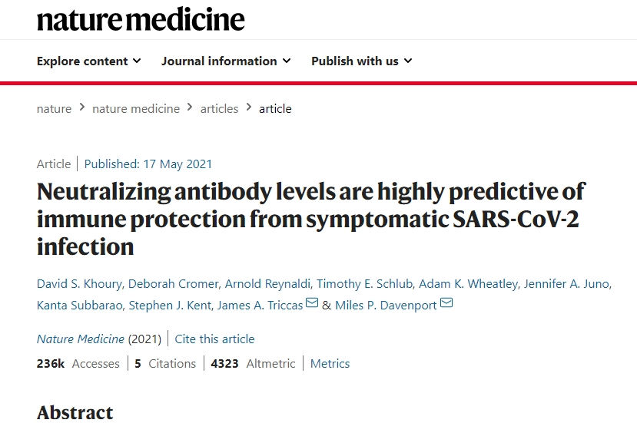
Science papers are used as a source and argument in scientific journalism.
What is a scientific paper and where can you find it?
Where can we find credible sources of information from science at all?

Slide 4
Not everything that is scientific paper is actually good science
We do not have to look for sources for scientific information only in scientific papers
There are also preprint scientific papers, which have not yet been reviewed and one should be careful with them
CREDIBLE SOURCES: (high-impact) factor peer-reviewed journals (ig. Nature, Science Lancet, Cell, NEJM)
Science news outlets (ig. EurekaAlert, AlphaGalileo)
...other (some science blogs – if they are reputable, no all of them! – ig. Science based medicine)

Slide 5
What is peer-reviewed science paper?
It was reviewed by experts from the same scientific field
The scientists who worked on it and published it did not go beyond their field of expertise
It also provides mathematical proofs (p-value, scalarity, measurability of phenomena) for conclusions

Slide 6
What is preprint paper?
It was published on a preprint platform (medRxiv, bioRxiv, etc.) for other scientists to see, but it has not yet been officially published in a peer-reviewed journal, nor has it been commented on by other scientists in the field – reviewers
It can be changed until published.
Some of preprints are never published

Slide 7
What are predatory journals?
These are journals that publish unreviewed "papers" at any time, even written by those who are not experts in the field, these journals do not review and anyone can publish anything.
Papers published in predatory journals are not material for science news - they can only be used for debunking.
There are lists of predatory journals and it is necessary to check whether the journal in which something was published is not on this list

Slide 8
Strength of evidence in science (especially medicine)
1. Meta-analysis
2. Double blind placebo controlled clinical trials
3. Everything else (Cell culture studies- in vitro, animal studies -in vivo, "preclinical studies" and IT models (in silico) - caution with reporting, small-size studies, case studies

Slide 9
Be carefull with:
Press releases (from universities, institutes, pharmaceutical companies)
Apstracts and posters from conferences (some of them are never published)
Anegdotal evidence

Slide 10
Noncredible sources:
Red alert if soomeone or some outlet promote alkalization, miracle cures (for cancer or nowdays for COVID19 suc as hydroxychloroquin or ivermectin), detox regimens, satanization of vaccines and classical medicine,
Sites that sell something
Sources that sound "scientific" but do not actually use the scientific method and steps

